Slide 1
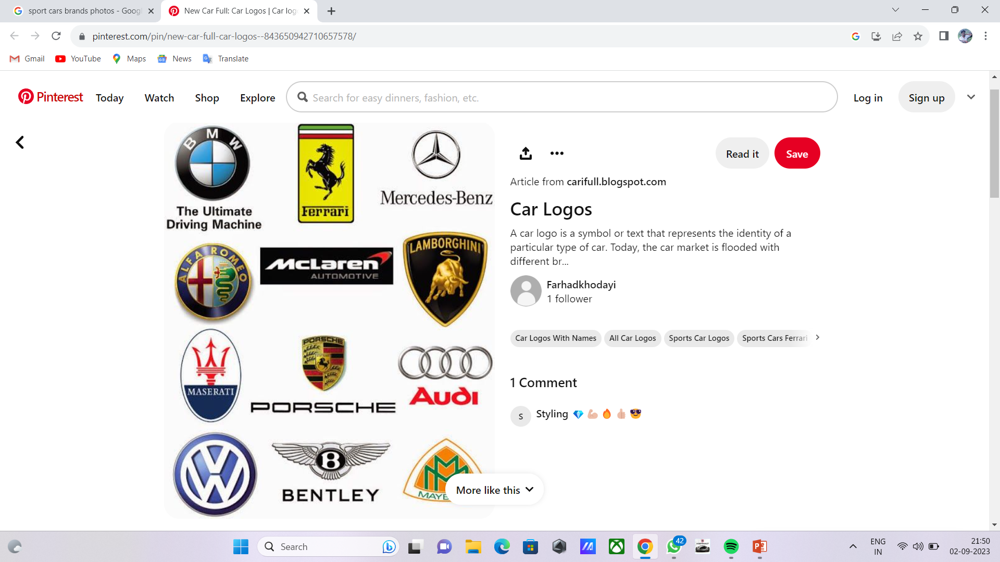
SQL PROJECt
DATABASE MANAGEMENT SYSTEM
CARS BRAND

Slide 2

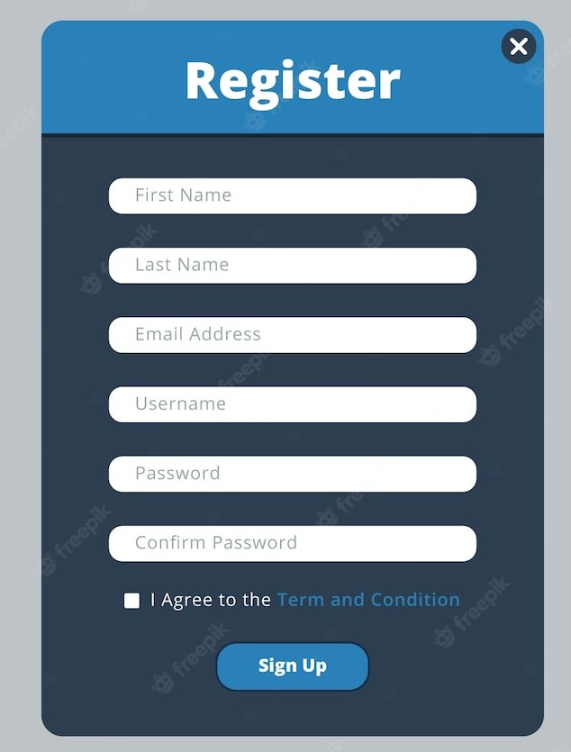
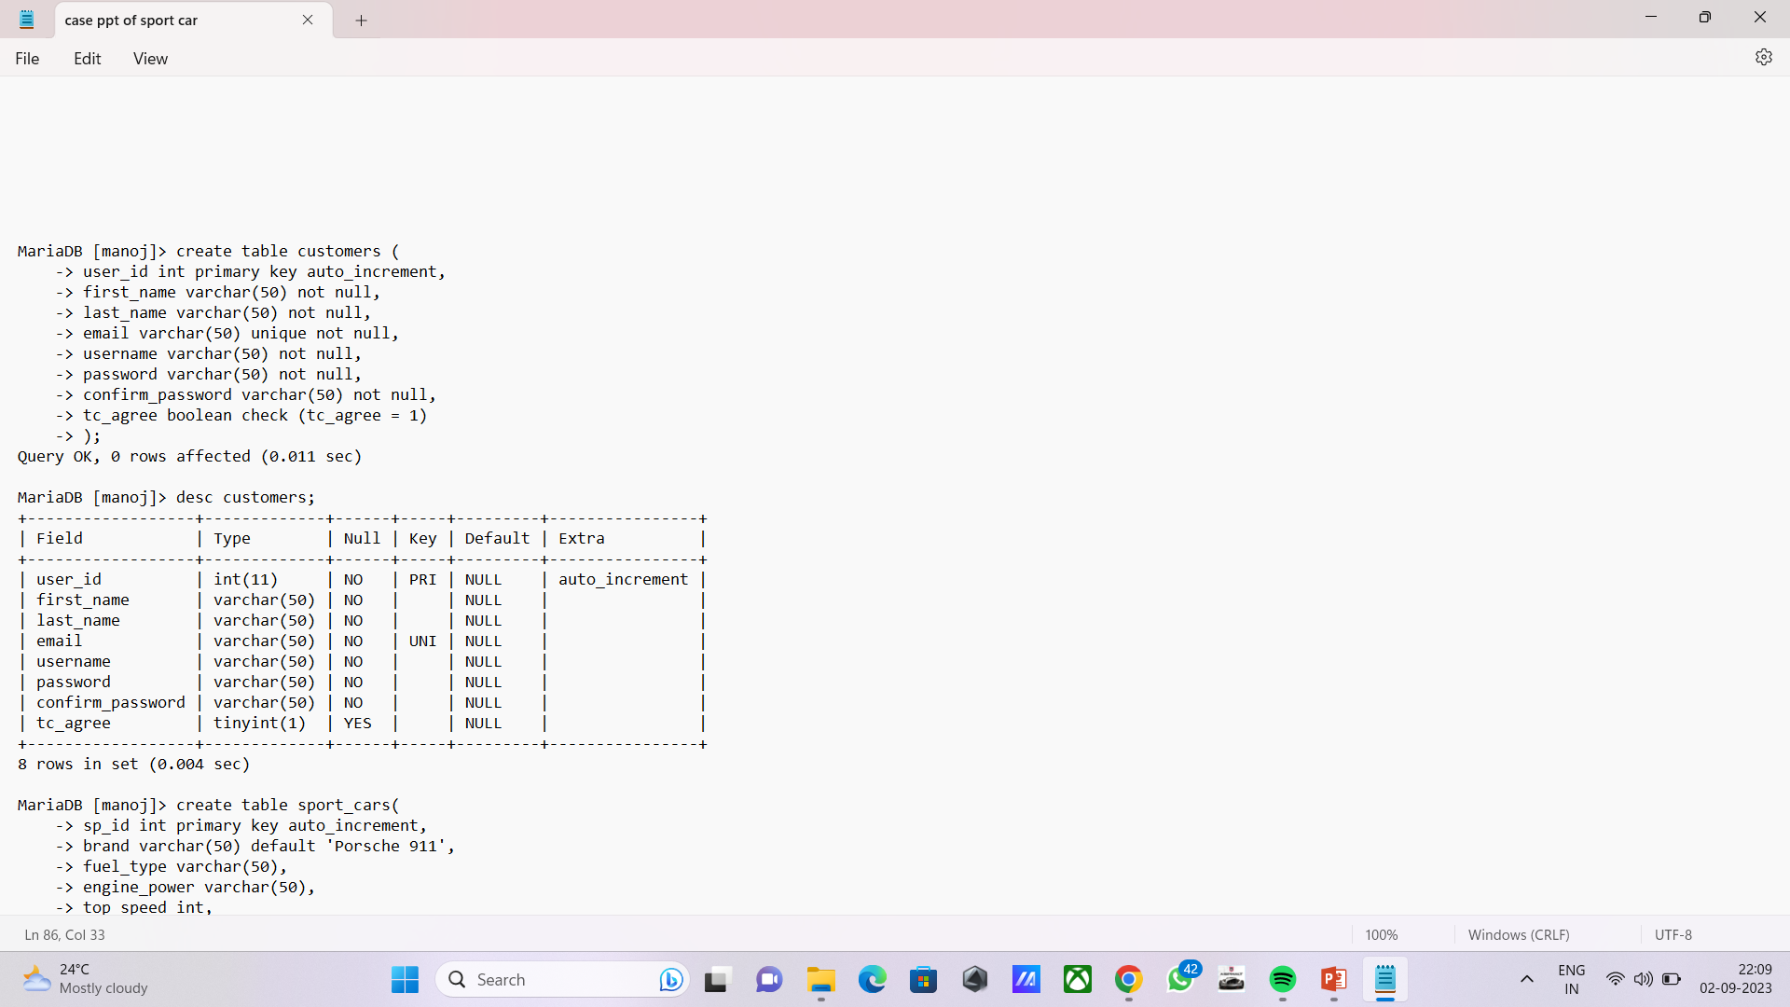
Query for create user table.

Slide 3
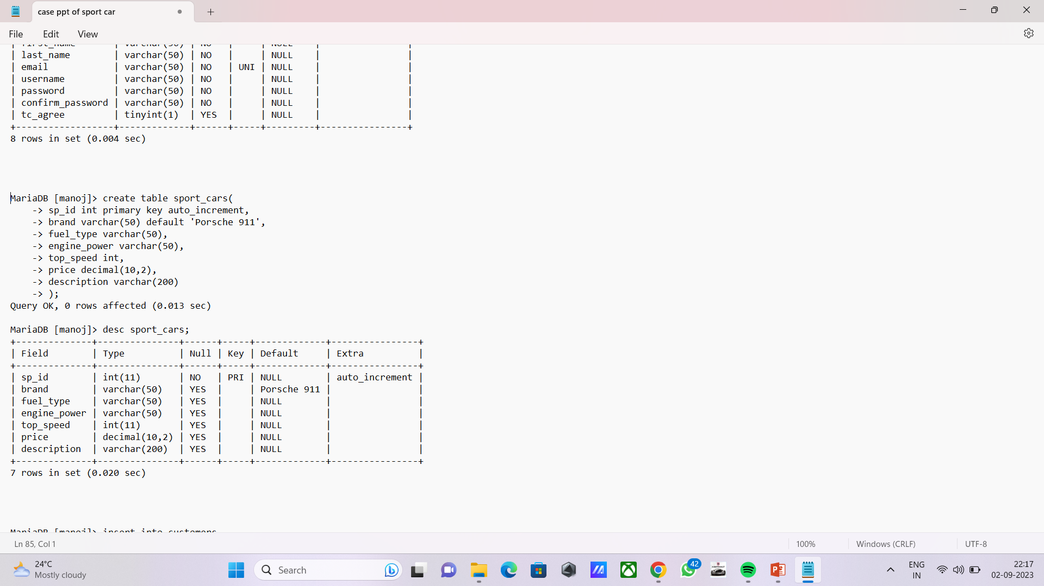
Create cars table :

Slide 4
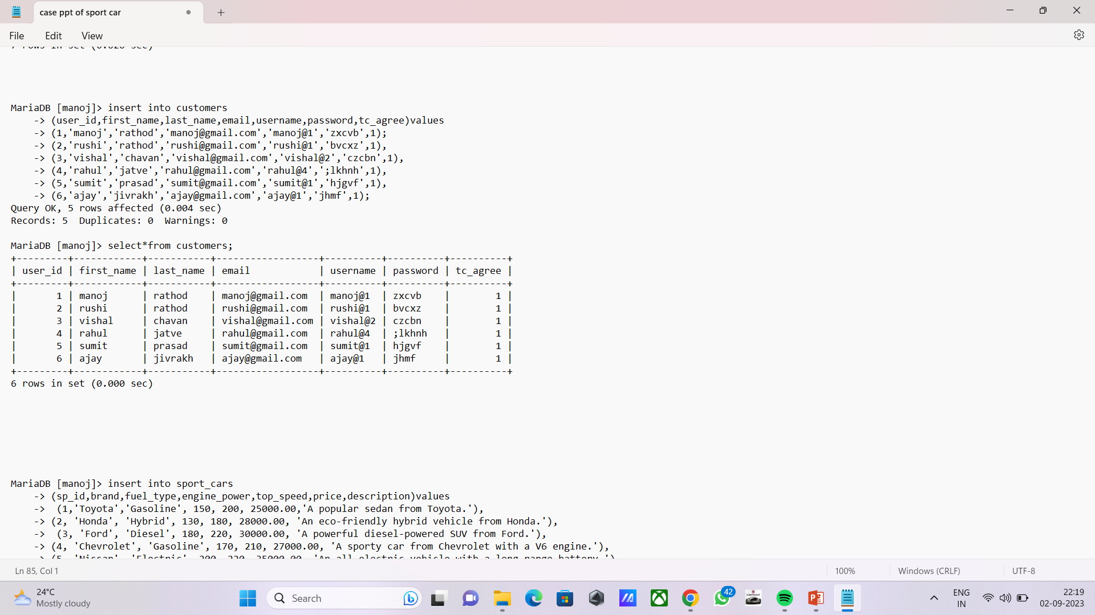
Show customers

Slide 5
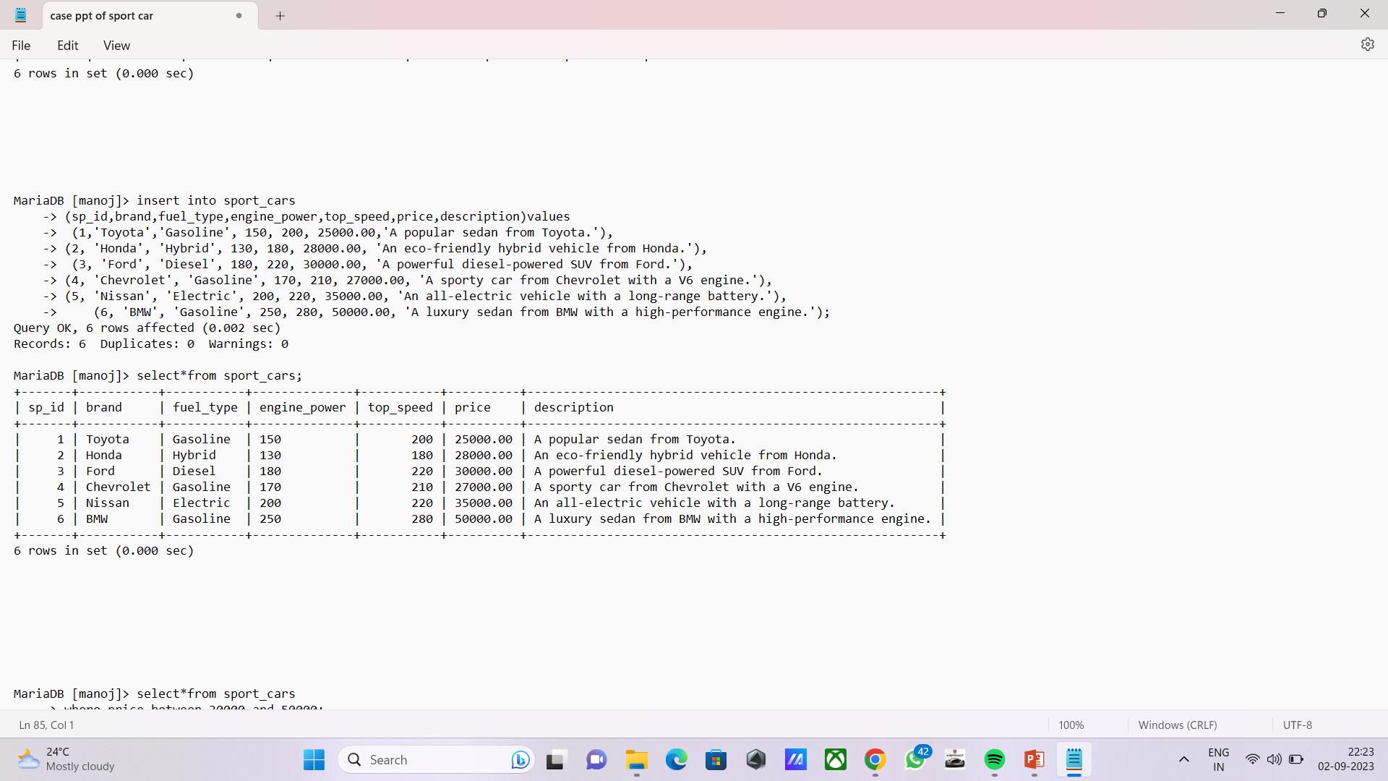
Show sport cars

Slide 6
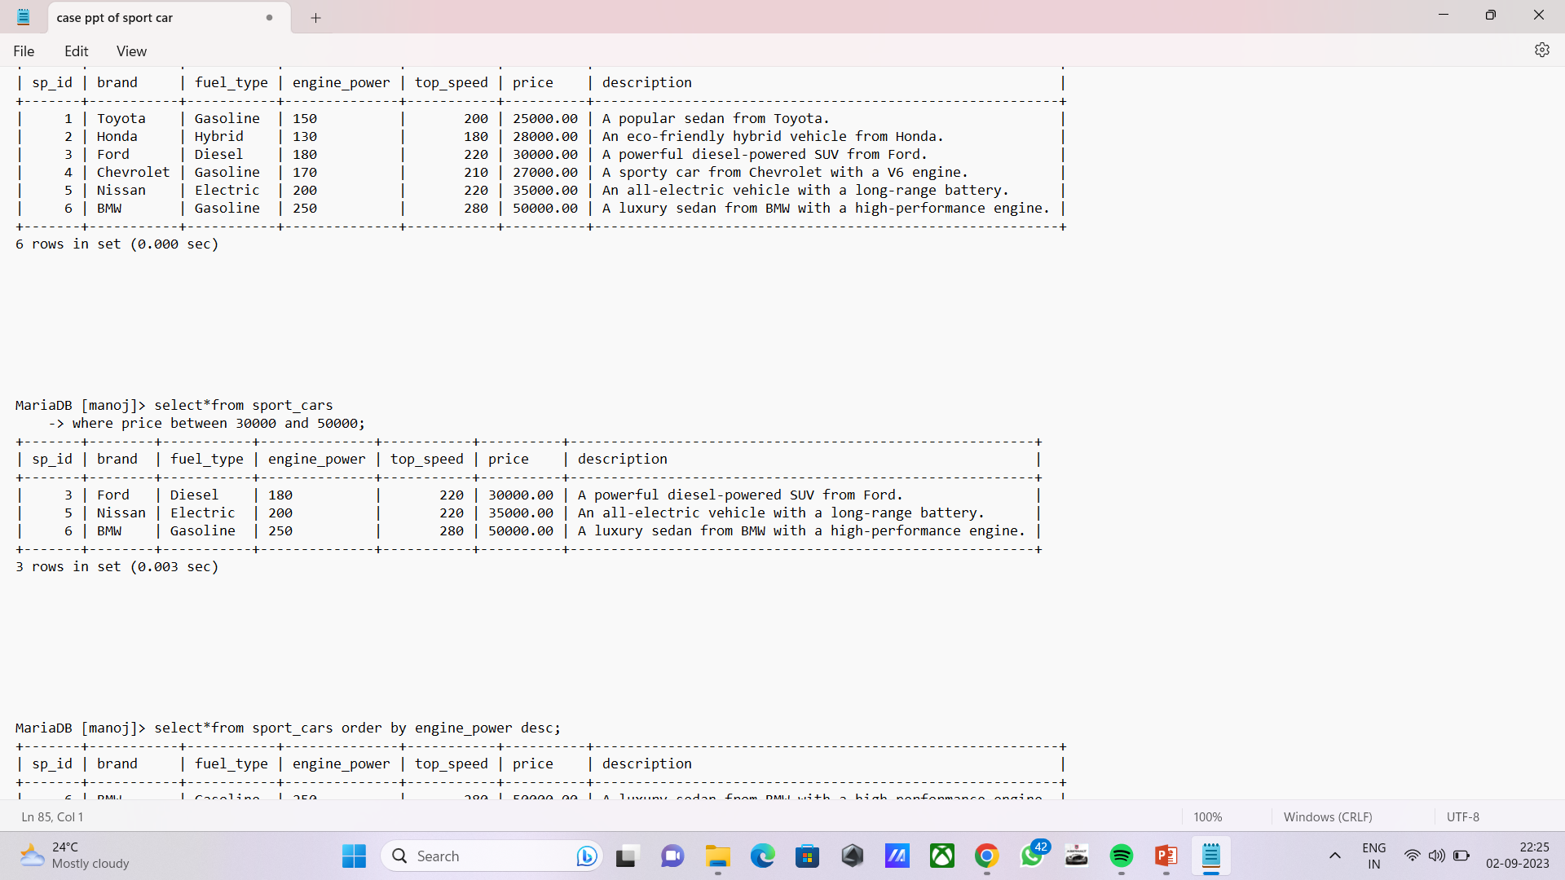



Show price between 30000 and 50000

Slide 7
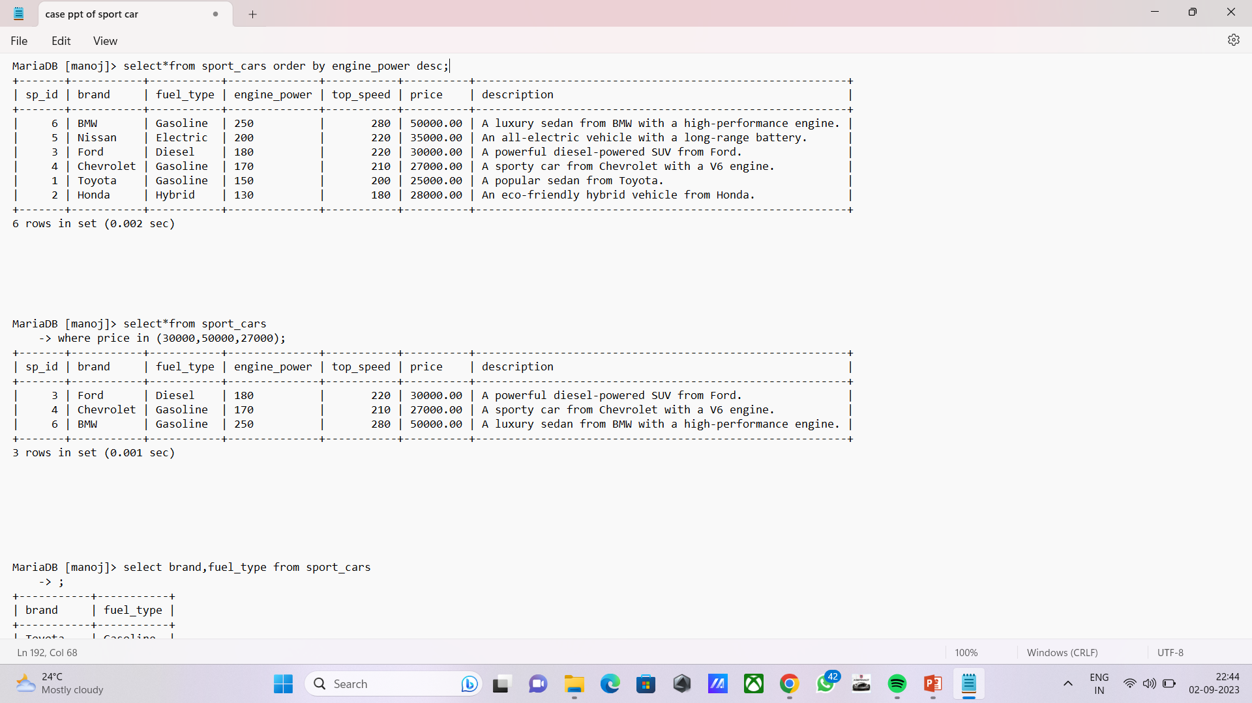
Show price in (30000,50000,27000)

Slide 8
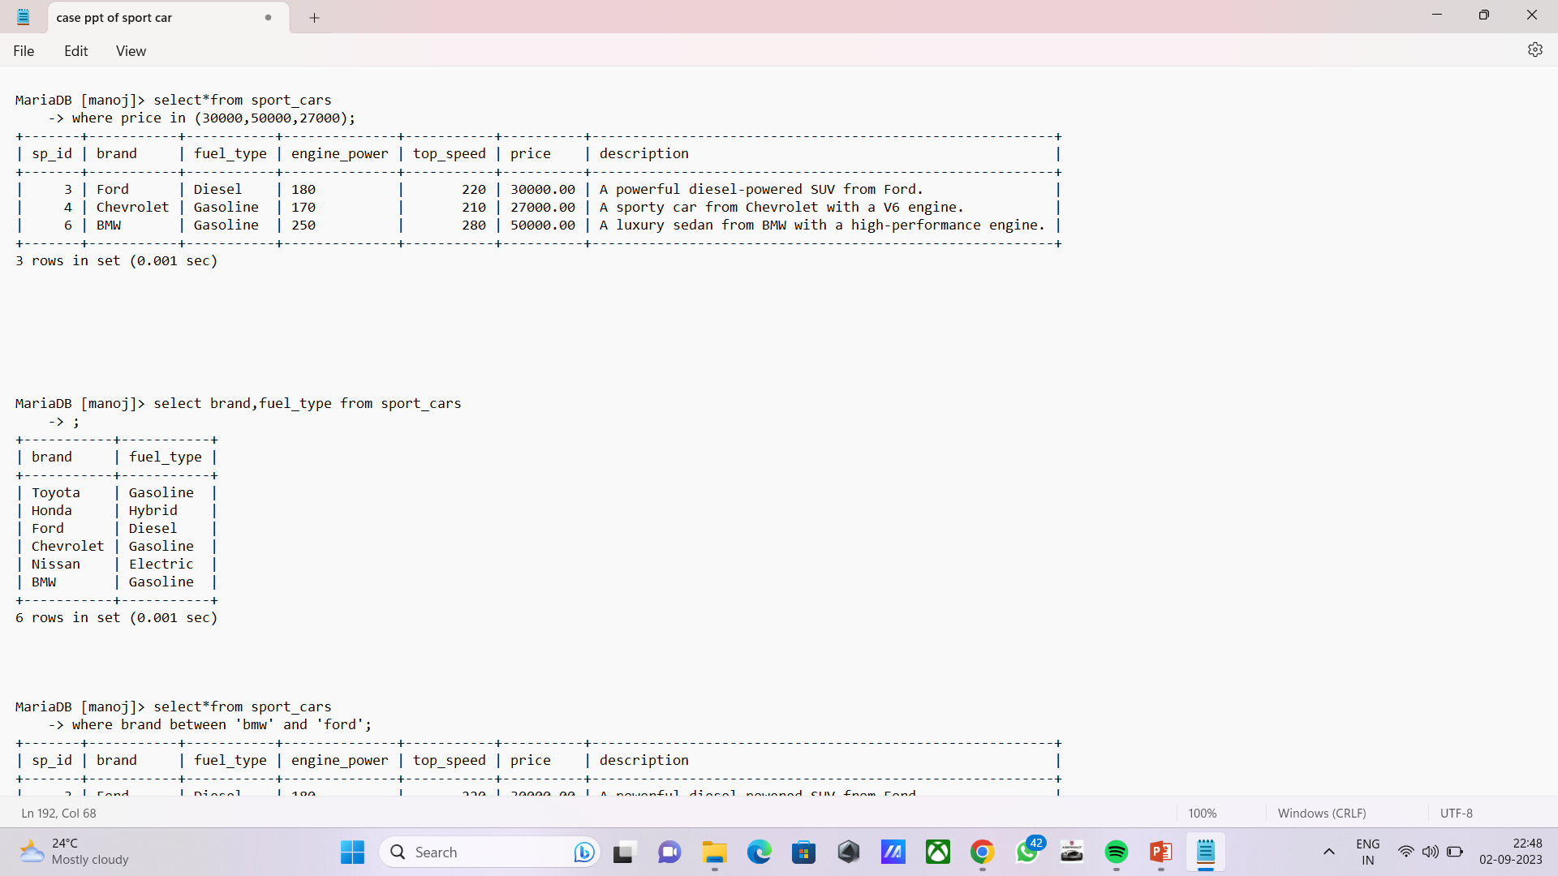


Show only brand & its fuel type :

Slide 9
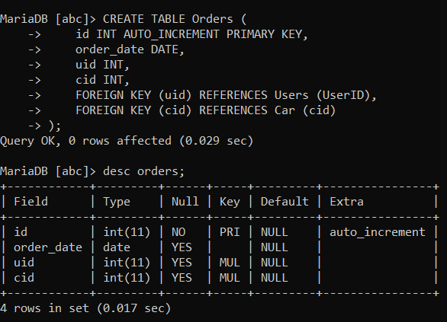
Create orders table :

Slide 10
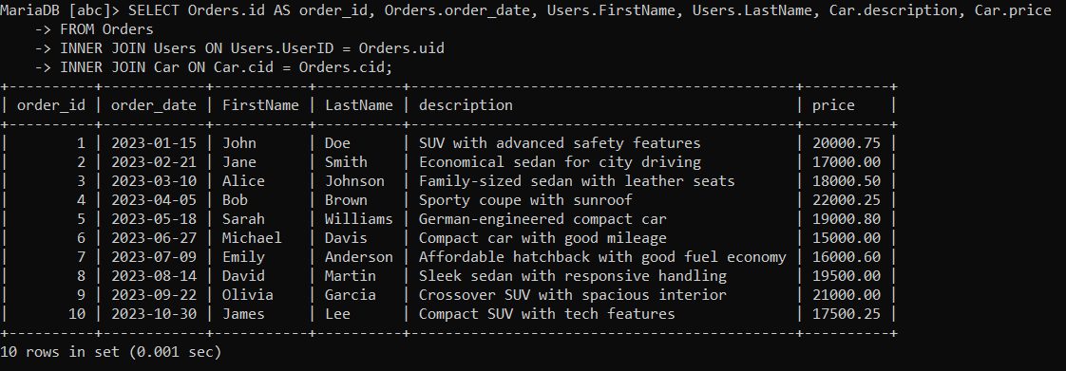
Show all orders with customer name and car description :

Slide 11
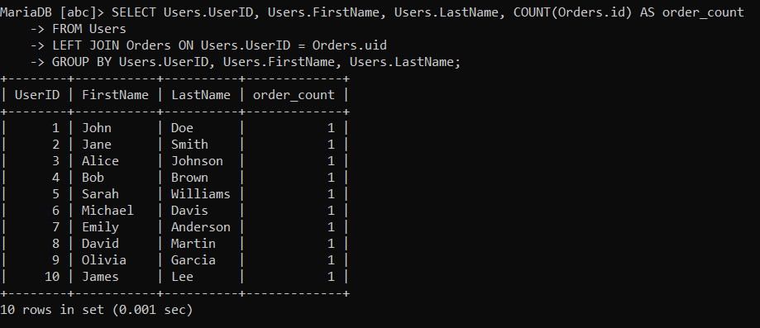
Show order count of every user :

Slide 12
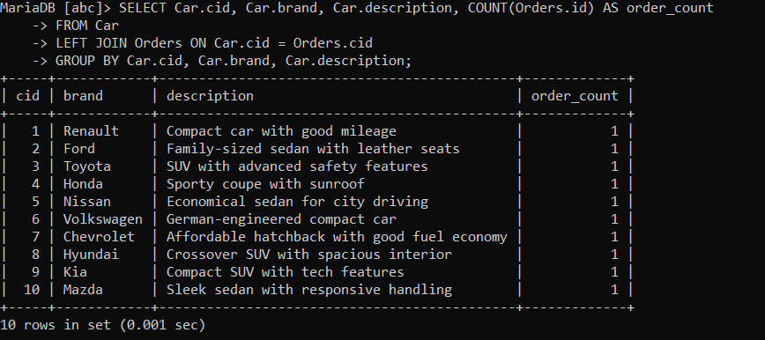
Show order count of every car :

